Slide 1
You Only Look Once: Unified, Real-Time Object Detection Joseph Redmon , Santosh Divvala, Ross Girshick, Ali Farhadi University of Washington , Allen Institute for AI , Facebook AI Research
영남대학교 전자공학과
지능형 시각정보 처리 연구실
2017. 08. 09
최 재 휘

Slide 2
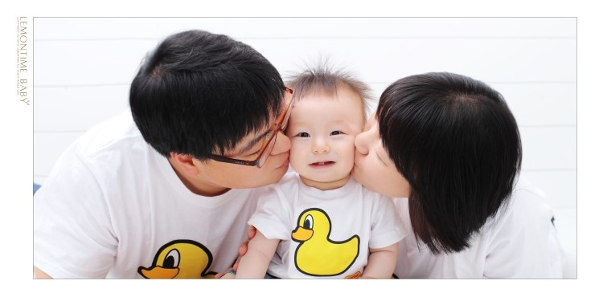
Look at this photo.

Slide 3
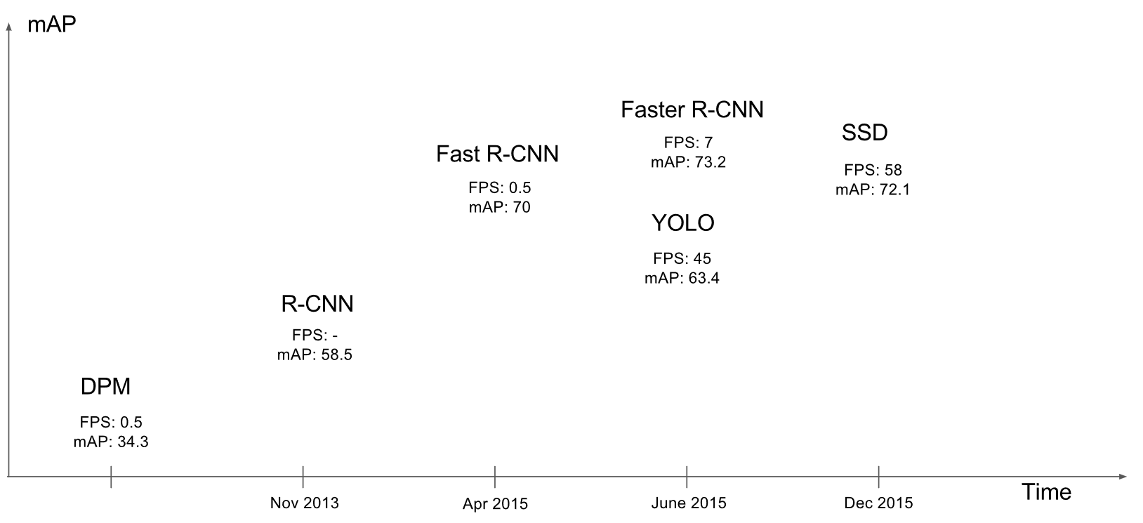
Each Program’s FPS and mAP

Slide 4
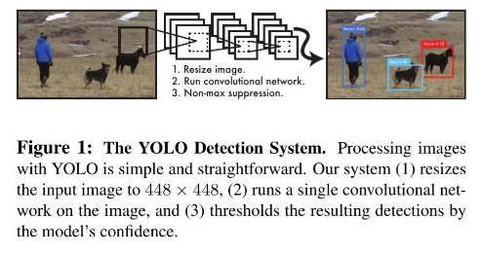
Processing method

Slide 5
3 strong points of YOLO
Extremely fast.
Bounding Box + Class Probability
-> Single regression problem!
2. predicts globally about the image when making predictions.
3. Learns generalizable representations of objects.
+ Still there are problems..

Slide 6
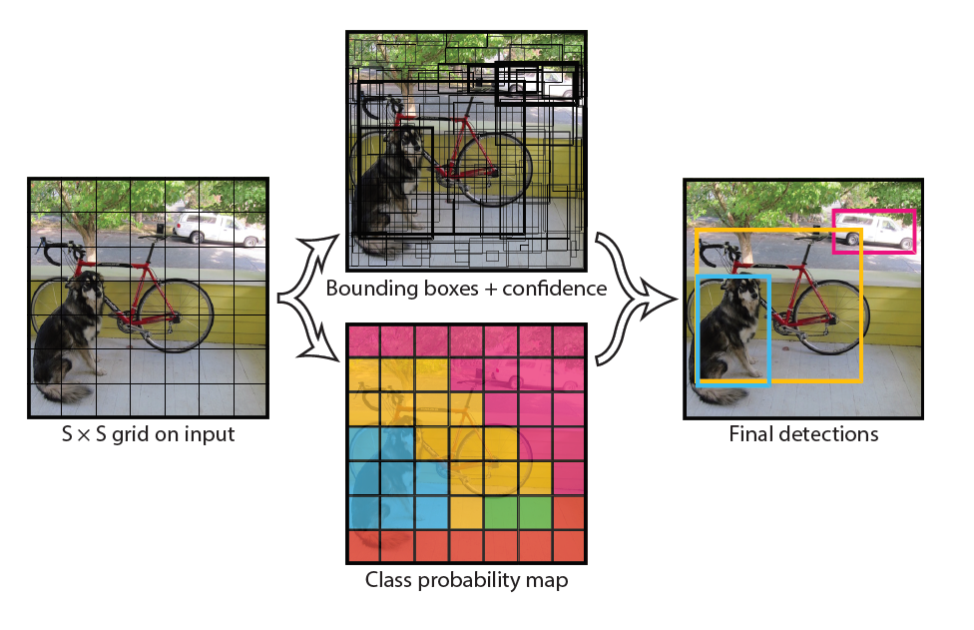
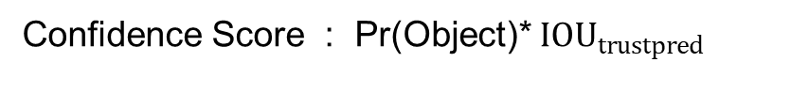
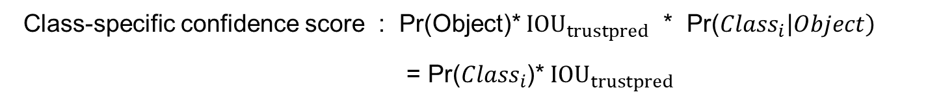
Simple explain about process
Confidence Score : Pr(Object)* ${IOU}_{trustpred}$
Conditional Class Probability : Pr(${Class}_{i}\left|Object\right)$
Class-specific confidence score : Pr(Object)* ${IOU}_{trustpred}$ * Pr(${Class}_{i}\left|Object\right)$
= Pr(${Class}_{i}$)* ${IOU}_{trustpred}$

Slide 7
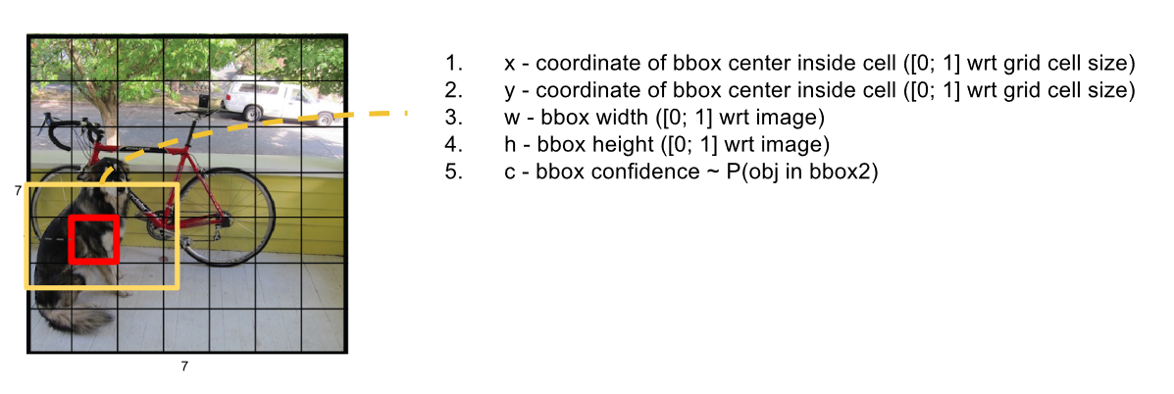
Conception
S, B, C
S : S * S grid cell
B : Bounding Box per each grid cell
C : The number of class

Slide 8
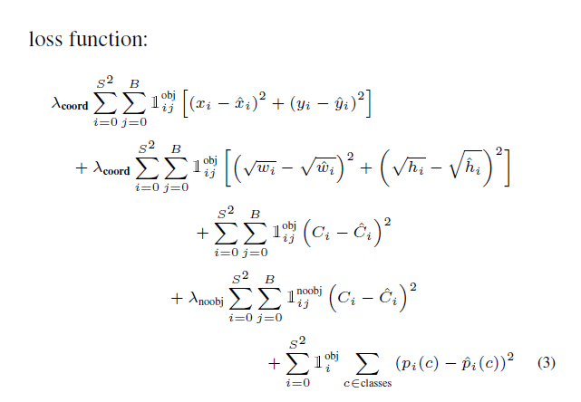
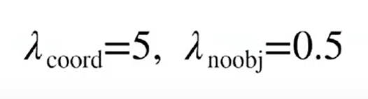
Loss function
A
B
C
D
E
S : S * S grid cell
B : Bounding Box per each grid cell
C : The number of class

Slide 9
Detail processing method
https://docs.google.com/presentation/d/1aeRvtKG21KHdD5lg6Hgyhx5rPq_ZOsGjG5rJ1HP7BbA/pub?start=false&loop=false&delayms=3000&slide=id.g137784ab86_4_2241

Slide 10
Conclusion
YOLO : Light, Simple, Fast!!!
https://www.youtube.com/watch?v=VOC3huqHrss

Slide 11
Reference
YOLO official site :
https://pjreddie.com/darknet/yolo/
YOLO paper :
https://pjreddie.com/media/files/papers/yolo.pdf
YOLO ppt1 :
https://docs.google.com/presentation/d/1aeRvtKG21KHdD5lg6Hgyhx5rPq_ZOsGjG5rJ1HP7BbA/pub?start=false&loop=false&delayms=3000&slide=id.g137784ab86_4_2241
YOLO ppt2 :
https://docs.google.com/presentation/d/1kAa7NOamBt4calBU9iHgT8a86RRHz9Yz2oh4-GTdX6M/edit#slide=id.g15092aa245_0_37
YOLO 실습 :
http://kinocoder.tistory.com/5

Slide 12
Thank you

Slide 13
